Slide 1
Mathis Finckh
N-Pulse Supervisor : Johann Lugon-Moulin
Academic Supervisor : Pr. A. Schmid
26.05.2026
Semester Project Final Presentation
Comprehensive Design of the Safety System of a Prosthesis

Slide 2
Overview
Context & Introduction: N-Pulse mission and the need for a software-controlled prosthetic safety system.
Hardware & Component Selection: Overview of the chosen sensors (thermal, humidity, electrical, mechanical) and the MCU power disconnect.
Software : Explanation of code logic
Engineering Justifications: Mathematical models validating thermal responses, capacitance, electromagnetic noise, and shock thresholds.
Conclusion & Next Steps: Final prototype results, physical limitations, and plans for future testing.

Slide 3
1. Context & Introduction

Slide 4
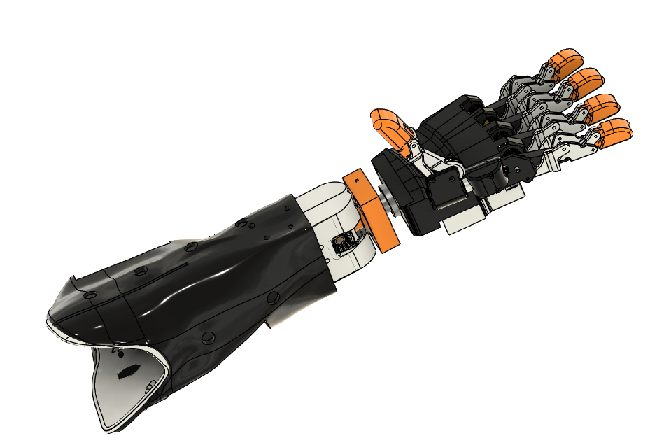
N-Pulse
EPFL MAKE project
Build cutting edge, open-source, accessible, non-invasive biomedical technologies
BMI : EMG, EEG, and computer vision controls
Prosthesis : Mechanical, electrical and software design of the arm

Slide 5
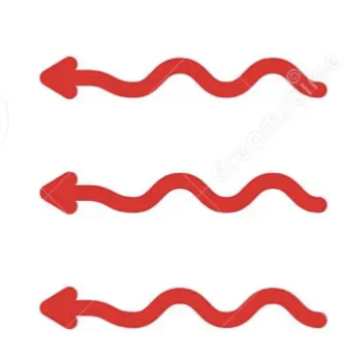

Current Safety Limitations
Currently fuse on power board as main protection
Risks :
Over Currents
Overheating in battery and motors
High temperature of ambient air for
electronics
patient skin contact
High relative humidity
High impacts
💥
Notes:
je pense que tu peux changer ou ne pas mettre cette image elle est beaucoup trop IA et elle n’apporte rien en plus

Slide 6
Project goal
Create software-controlled battery disconnect system
Monitors sensors for each risk
Provide diagnostic data for troubleshooting
Live visualization
Data storage and analysis
Electrically controlled battery disconnect
💥
Notes:
je pense que tu peux changer ou ne pas mettre cette image elle est beaucoup trop IA et elle n’apporte rien en plus. Tu as prévu de parler beaucoup du fait de pouvoir déconnecter la batterie ? si la réponse est non car on a pas reçu le composant principal mentionne et explique bien comment tu voulais l’utiliser

Slide 7
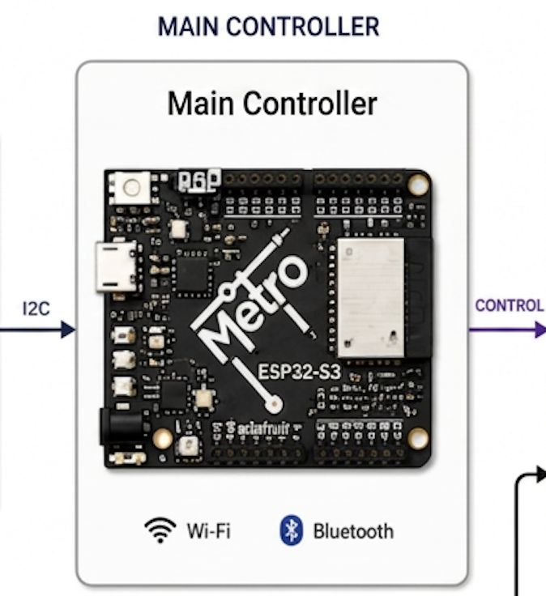
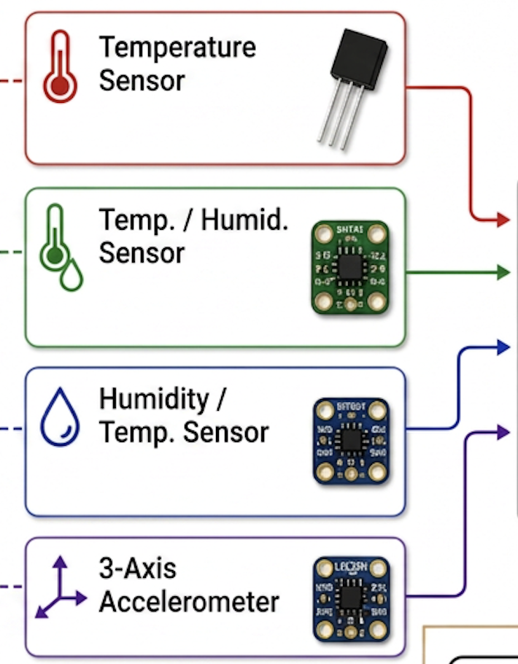
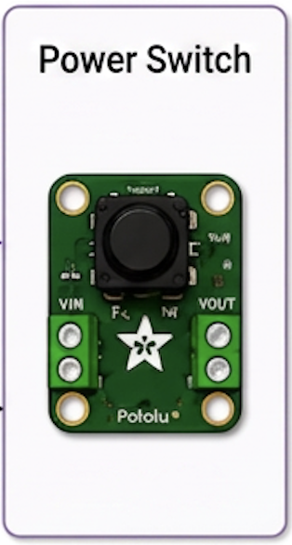
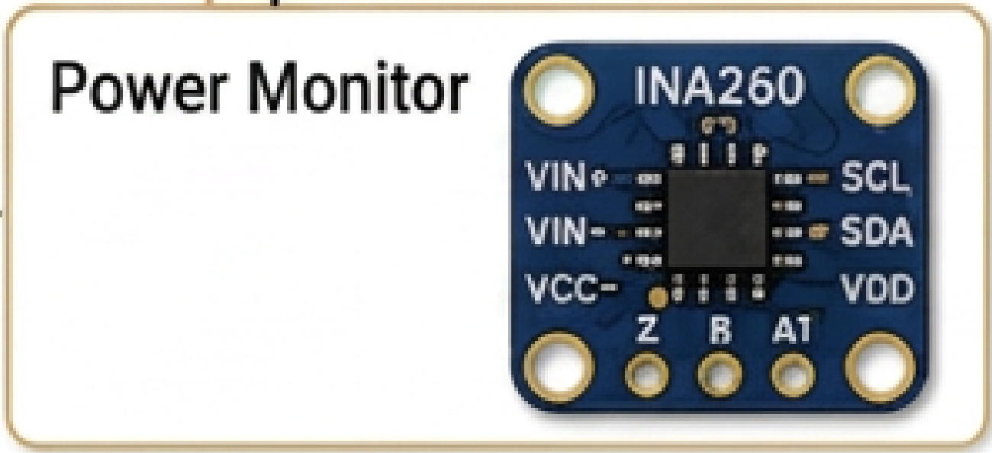
Solution Visualisation
Battery
Notes:
Fait gaffe on fait un avant bras seulement pas tout le bras. la batterie c’est du 4S et pas du 3S. simplifie le

Slide 8
2. Hardware & Component Selection

Slide 9
Component wise limits
Component | Range | Source
Battery | 0 to 60°C (45 from QMS | QMS (manifacturer recomendation)
Motor casing | -10 to 80 °C | Datasheet
Electronics | -40 to 85 °C | Different sources, general electronics safety
Socket | max 41°C on skin | Medical device safety
Shock | 16g | Chosen
Humidity | 70% very safe | Different sources, general electronics safety

Slide 10
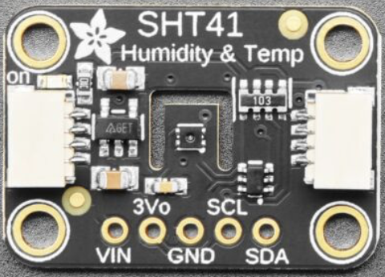
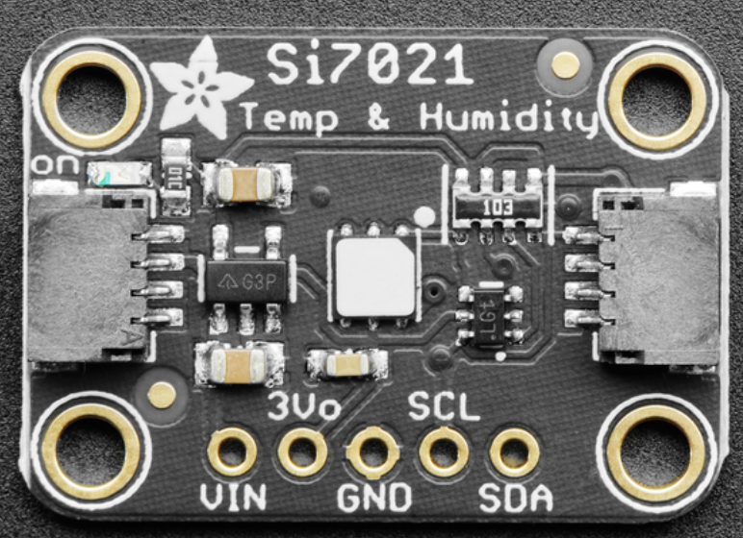
Relative Humidity Sensor
Need :
Compact enough to fit inside the prosthetic enclosure
Able to monitor humidity (up to 100%) as well as ambient temperature
Easy to integrate into the existing I2C-based system
Chosen sensors:
Adafruit SHT41 (inside arm, near electronics)
Measures relative humidity and temperature with high precision.
Very low power consumption.
Suitable for enclosed spaces where moisture buildup may matter.
Adafruit Si7021 (Socket)
Idem with protective PTFE filter (for more exposed usage at socket)

Slide 11
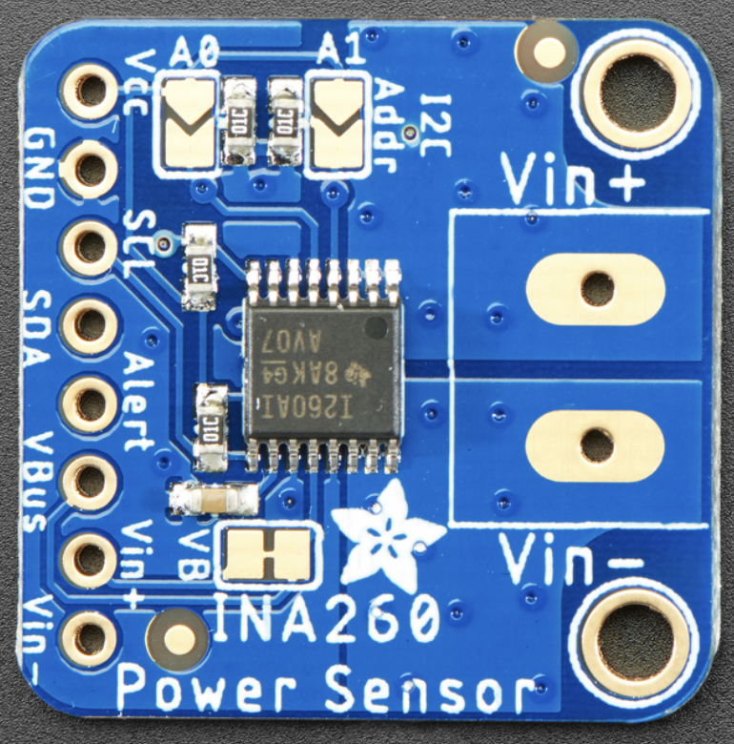
Current Sensor
Need :
Must monitor battery current in real time.
Should help detect overcurrent, short circuits, or abnormal power draw : Max 5.3 A from motors
Can handle >2x max current (10.6A)
Easy to use with the main controller during prototyping.
Chosen sensor: Adafruit INA260
Measures current, voltage, and power in one device.
Works over I2C
Programmable alert capability.
Can handle 15A continuously
Designed for straightforward integration into battery monitoring.
Notes:
volontiers si tu mets des chiffres c’est plus compréhensible et on connait mieux les specs du capteur

Slide 12
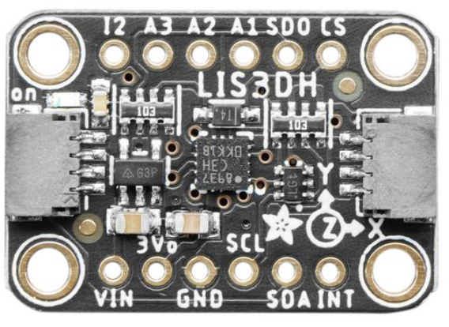
Accelerometer
Need :
Must detect sudden shocks, falls, or abnormal impacts (>10g)
Should be sensitive enough to identify dangerous mechanical events.
Compact and easy to mount on the prosthetic structure.
Chosen sensor: Adafruit LIS3DH
3-axis accelerometer with a ±16 g full-scale range.
Includes hardware interrupts for shock or free-fall events.
Small, low-power, and well suited to embedded safety detection.
10’000 g high shock survivability

Slide 13
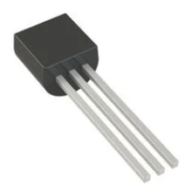
Thermal Sensor
Need :
Small enough to be attached to motors, battery, and socket
Can withstand and sense >85° (max. allowed motor casing temp)
Easy to use for prototyping and implementation
Chosen sensor : DS18B20
Measures Temperatures from -55°C to +125°C
1-Wire® Interface (no calibration)
Small : < 1cm

Slide 14
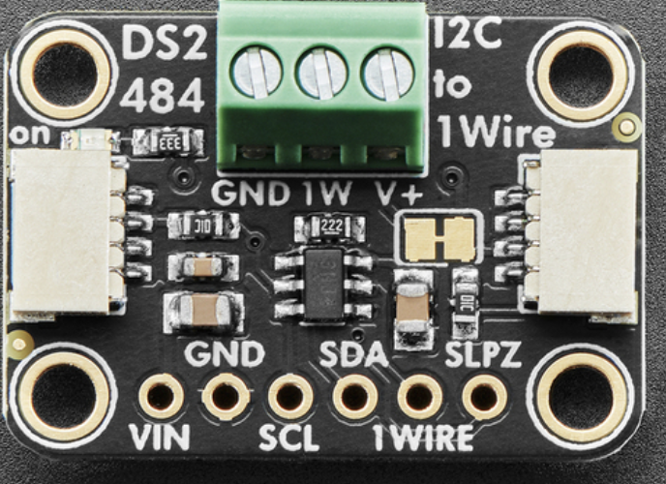
1-Wire to I2C Adapter
Need :
Must allow the 1-Wire thermal sensors to communicate with the main controller
Should simplify wiring to only have I2C cables passing by the wrist
Chosen component : Adafruit DS2484
Converts 1-Wire to I2C communication.
Makes it easier to integrate multiple DS18B20 sensors.
Reduces software and wiring complexity.
Notes:
it convert from 1-Wire to I2C no ?

Slide 15
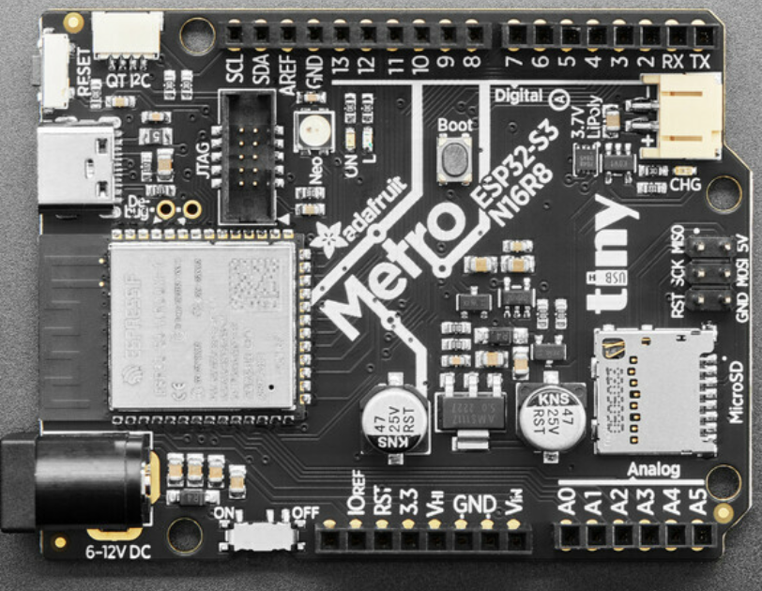
Microcontroller
Need :
Handle 2 separate I2C lines
Enough performance for future expansion and diagnostics.
Extra pins for hardware interrupt
Possibility for wireless communication
MicroSD slot for data storage in case of failure and power cut.
Low consumption
Chosen MCU: Adafruit Metro ESP32-S3
Powerful MCU with wireless capability.
Supports both I2C and 1-Wire-related system architecture.
Good fit for a safety-oriented embedded prototype.
Many pins
MicroSD slot
60-80 mA in use
Low Power deep sleep mode (100uA)
Stemma QT connector for quick prototyping

Slide 16
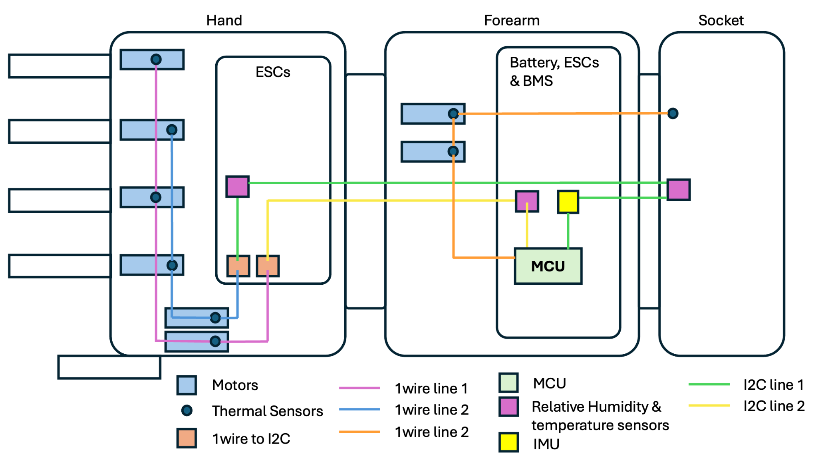
Bus Architecture
Battery
Notes:
il nous manque des légende pour un peu mieux comprendre. Les numéros des modèles sont abstrait donc met plus quel type de capteur c’est avec par exemple des carrés de la couleur tel pour tel type de capteur et uniformise la couleur des lignes en fonction du type de data ou surtout met la légende car la je ne sais ce qui est quoi

Slide 17
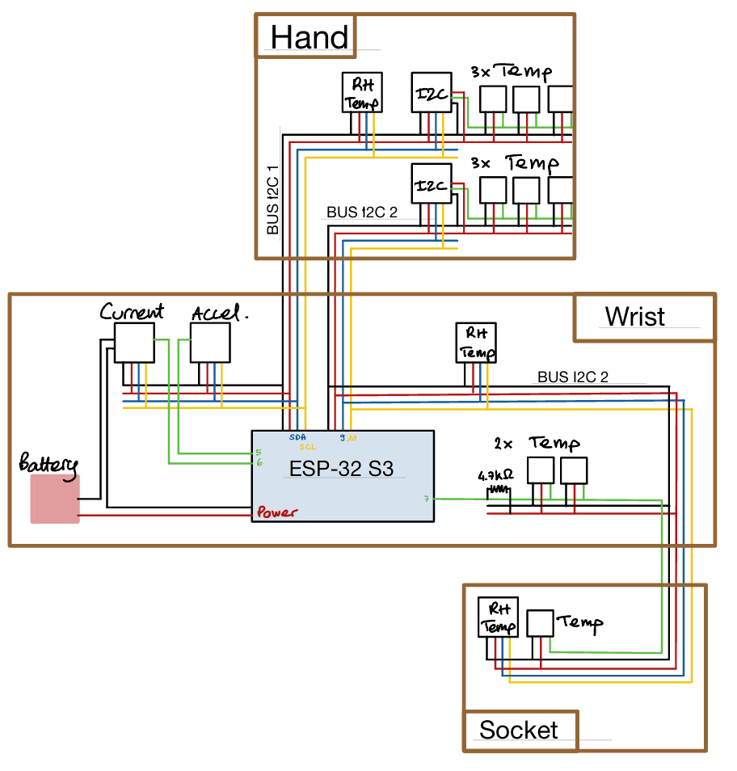
Bus Architecture
Notes:
il nous manque des légende pour un peu mieux comprendre. Les numéros des modèles sont abstrait donc met plus quel type de capteur c’est avec par exemple des carrés de la couleur tel pour tel type de capteur et uniformise la couleur des lignes en fonction du type de data ou surtout met la légende car la je ne sais ce qui est quoi

Slide 18
3. Software

Slide 19
Embedded Safety Logic – Pseudocode
Initialize sensors and interrupts
Loop:
check interrupt-based faults
If a critical fault is confirmed:
request power cut
update temperature measurements
every logging period:
read all sensors
evaluate thresholds
log data
update warning LED

Slide 20
3. Engineering Justifications & Modeling

Slide 21

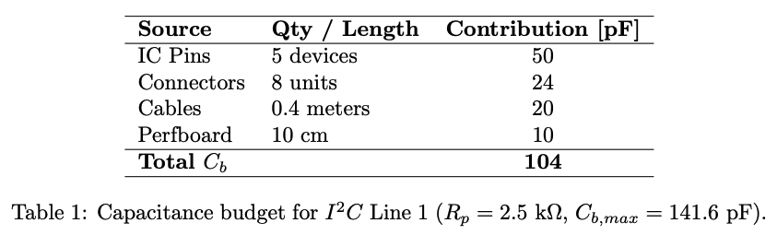
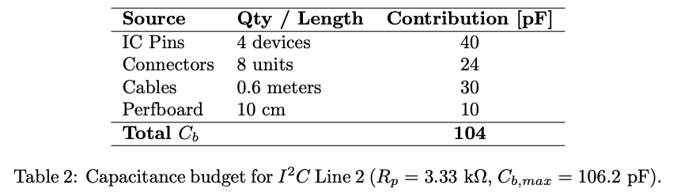
I2C Capacitance Budgeting
Sources of capacitance : pins, connectors, cables, perfboard stray capacitance, sensor themselves
Parallel pull-ups on sensor breakout boards (10kΩ each), sets line resistance and therefore the real capacitance limit
Empirical confirmation: communication worked on the prototype
Could theoretically allow for ~10 sensors on 1 line before hitting minimum resistance limit

Slide 22
Electromagnetic Noise & Crosstalk
Casing damps most of direct noise (Faraday cage), most risk between cables (Crosstalk, due to back flow of commutation and PWN noise)
Modeled geometry: motor and I2C cables parallel, 5 mm apart, over 50 mm
Coupling mechanisms: capacitive and inductive
Noise estimates
Stall case: about 2.13 mV
Nominal operation: about 1.63 mV
I2C Low-level margin: 330 mV → Safe
Checked experimentally by routing cables close together and looking for abnormal readings → No disturbance

Slide 23
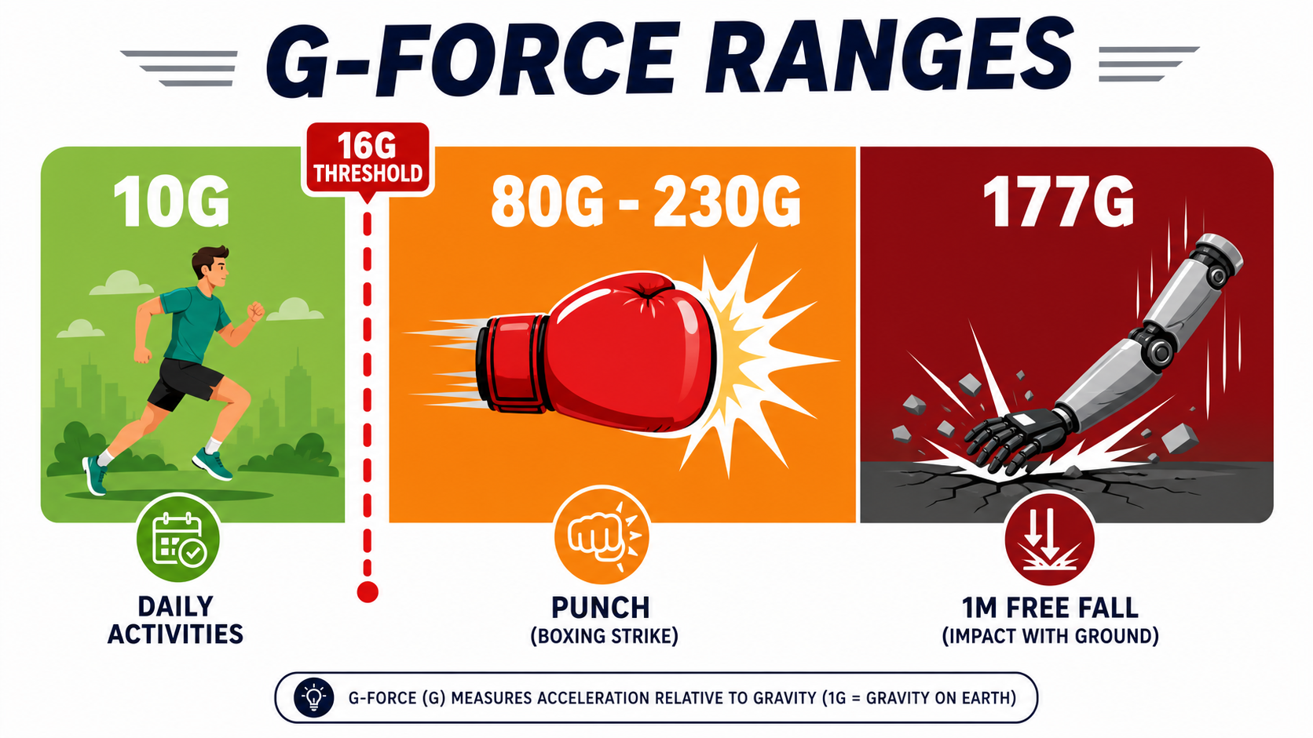
Shock Detection Thresholds
Everyday activities can reach up to about 10 G at wrist (running, jumping)
Literature values for harsh events:
punch: about 80–230 G
fall on outstretched hand: about 80–130 G
Simple drop estimate: ~ 177 G (1m fall, 4ms impact)
Selected threshold: 16 G, matching the LIS3DH full-scale range
Gray zone of exact implementation, will require testing (hard knocks ?)
Notes:
same as the previous image we have a front arm and not a full arm and this image is for nothing maybe better to just remove it. How did you estimate the 177G explain it

Slide 24
System Reaction Time
Main loop idle execution time: about 5–15 µs (240MHz)
Current fault reaction time: about 1.3 ms, dominated by INA260 conversion time
Shock fault reaction time: about 20 ms, dominated by the LIS3DH duration filter at 200 Hz and 4 samples
Design interpretation:
fast electrical faults are cut almost immediately
shock detection intentionally requires persistence to avoid false positives (doesn’t require instant reaction either way)
The architecture is hybrid: fast interrupt-based protection for urgent events, slower periodic monitoring for slow variables

Slide 25
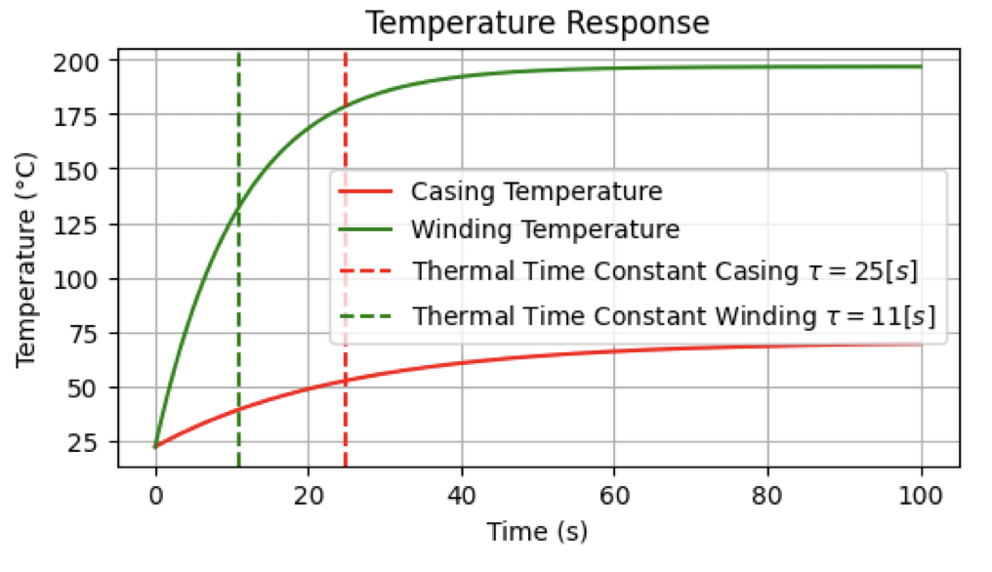
Poling Frequency & Thermal Response
Current and shock interrupt-based
Temperature only variable potentially limited by polling frequency
Under stall, the winding reaches 100°C in about 6.5 s, while the casing is still only about 33°C
25 s much slower that 0.5 s poling time
→ casing temperature is useful for user/structure protection and diagnostics, but not for direct winding protection under stall
*Thermal resistance : 63% of the steady state temperature

Slide 26
5. Conclusion and Results

Slide 27
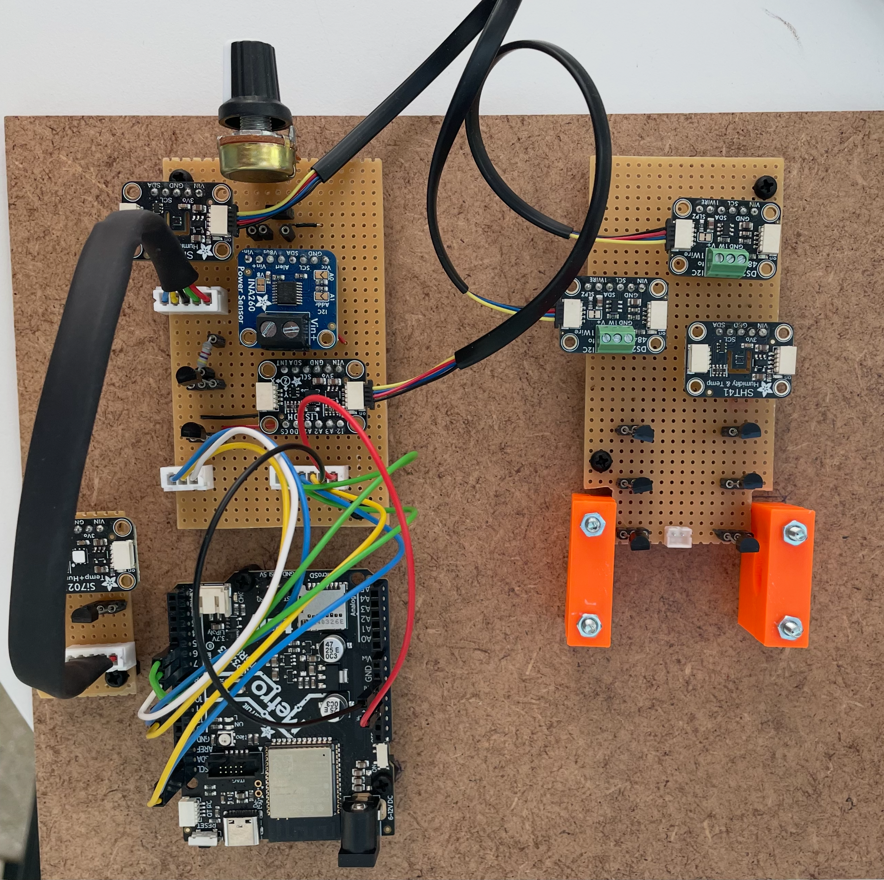
Final Results & System Successes
I2C & 1Wire communication successful
Reacts to hardware interrupt
Flags passed thresholds
Complete build of test bench
Notes:
oublie pas de prendre ta plaque avec pour la présentation

Slide 28
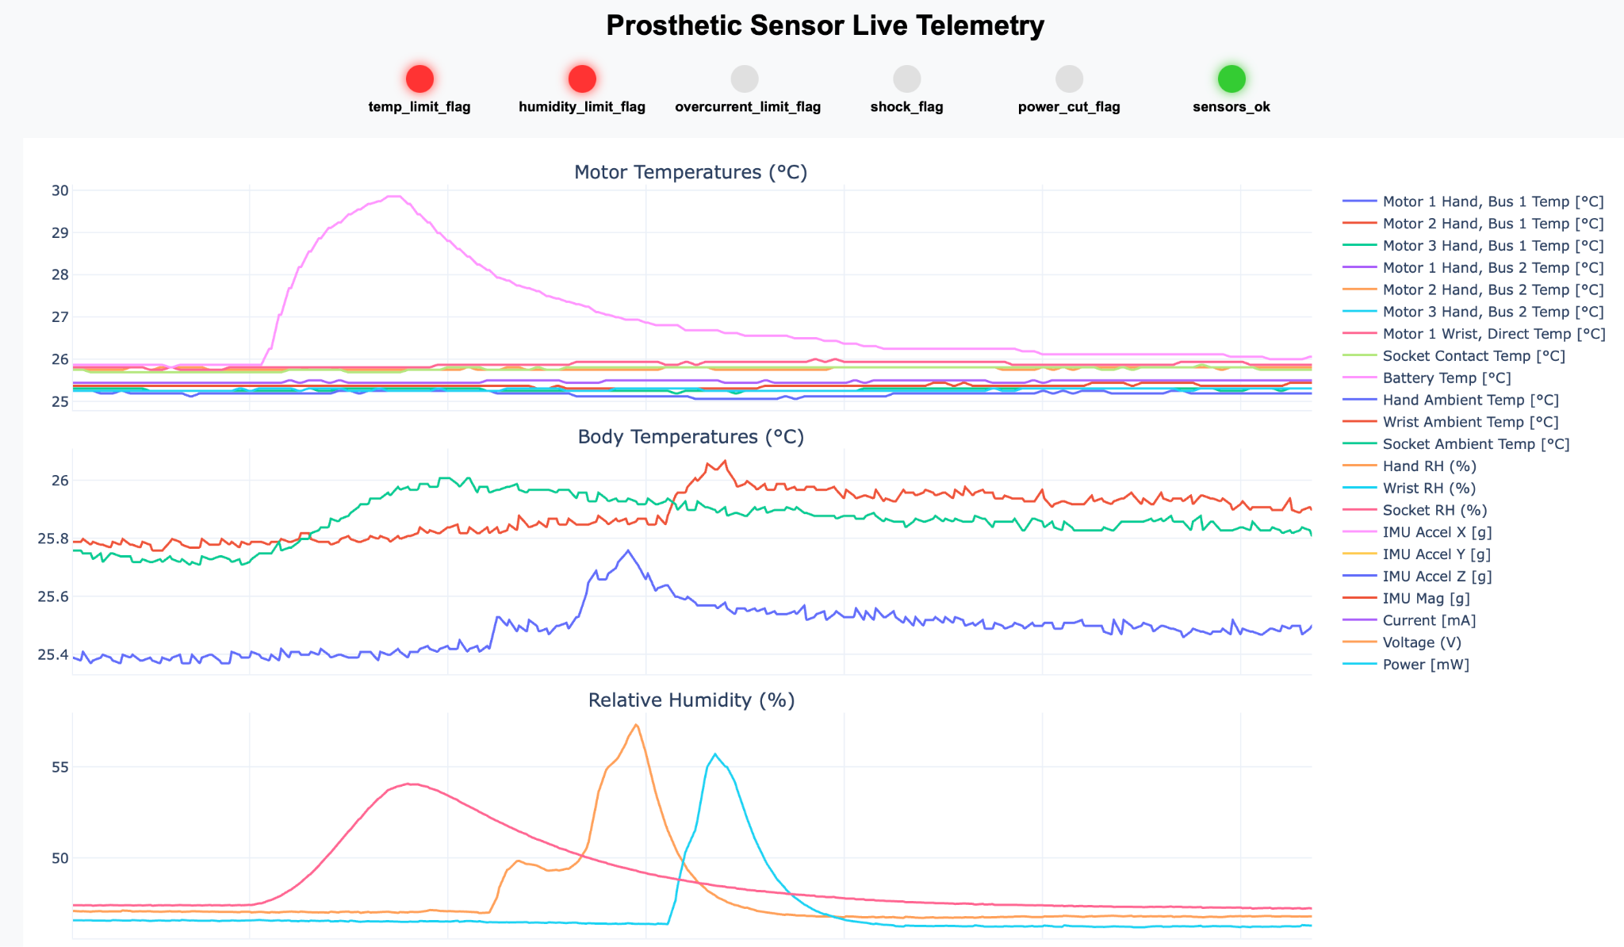
Final Results & System Successes
Graphical User Interface (GUI)
Live plotting of measured metrics
Visualisation of flags
Visualisation of power cut
Possibility to remove some metrics from the view
GUI
Notes:
il y aurait moyen de mettre une vidéo comme ça on voit les datas bougé ou alors tu montres en vrai je ne sais pas quel est ton plan

Slide 29
Known Limitations
Power button & MicroSD logging not implemented or tested since hardware never arrived
Very simple prototype, needs to be completely reworked to be implemented or tested with the arm
Likely false positives (power cut) in case of a hard knock, requires calibration on final implementation (worst cast sensor with wider g range)

Slide 30
Next Steps
Go further on the prototype
Implement Power cut switch and data storage
Testing with motor under load (Electromagnetic noise, overheating ?)
Prediction using gradient
Implement on the real prosthetic to validate before redesign
Redesign
PCB for the hand that regroups all sensors
PCB for MCU and wrist sensors
Notes:
precise quel sont tes steps restant pour ce fin de semestre

Slide 31
Questions ?

Slide 32


epfl-npulse.ch
contact@epfl-npulse.ch

